Slide 1
XGBoost Regression Algorithm
An overview of the XGBoost regression model and its applications

Slide 2
Overview of XGBoost
XGBoost (Extreme Gradient Boosting) is an efficient and scalable implementation of gradient boosting.
It is widely used for supervised learning tasks including regression, classification, and ranking.
Key features include regularization, parallel processing, and handling of missing values.

Slide 3
How XGBoost Regression Works
1. Builds an ensemble of decision trees sequentially.
2. Each tree corrects the errors of the previous ones.
3. Uses gradient descent to minimize the loss function.
4. Supports regularization to prevent overfitting.

Slide 4
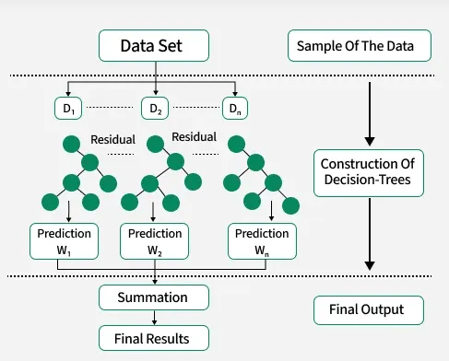

Slide 5
Key Parameters in XGBoost
- n_estimators: Number of boosting rounds (trees).
- learning_rate: Step size shrinkage.
- max_depth: Maximum depth of a tree.
- objective: Loss function (e.g., 'reg:squarederror' for regression).
- subsample: Fraction of samples used per tree.
- colsample_bytree: Fraction of features used per tree.

Slide 6
Python Example
!pip install lightgbm
from lightgbm import LGBMRegressor
regressor =LGBMRegressor(n_estimators=100, learning_rate=0.1, max_depth=3, min_data_in_leaf=1,min_data_in_bin=1)
regressor.fit(X_train, y_train)

Slide 7
Use Cases of XGBoost Regression
- Predicting house prices
- Forecasting sales and demand
- Modeling customer lifetime value
- Financial risk modeling
- Energy consumption prediction

